Slide 1
Bitrix Intranet
version 11.5 presentation

Slide 2
What is new in version 11.5?
Social Interfaces and new collaboration scenarios;
Activity Stream and Conversations;
Brand new Instant Messenger and Contacts
Improved design and usability in Workgroups
New concept for working in the Extranet
Tasks and CRM integration in Business Processes
Drag-n-Drop Visual Company Structure
Redesigned Calendars and Absence Chart
Fresh look of the product and new pricing

Slide 3
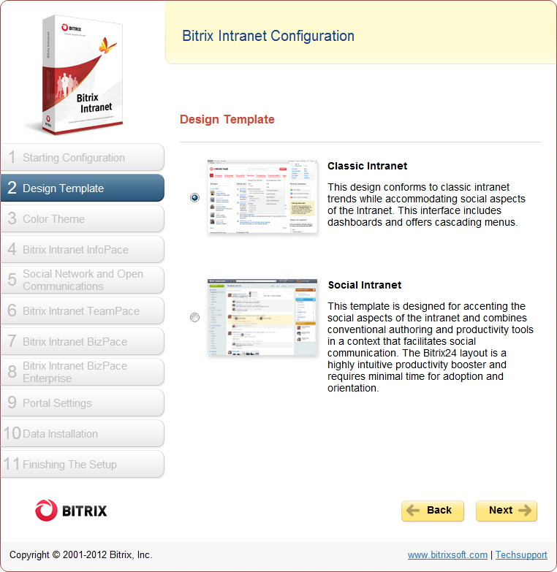
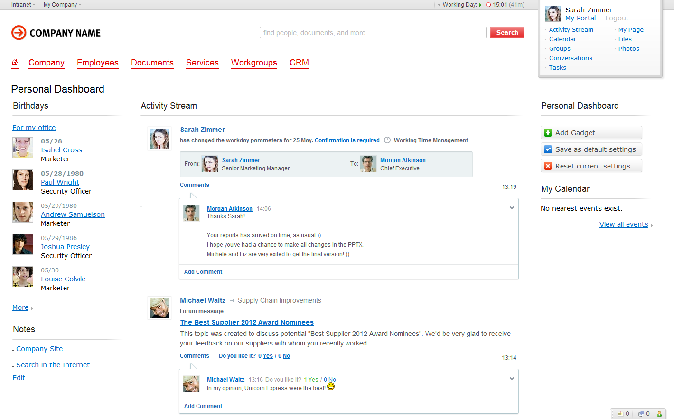
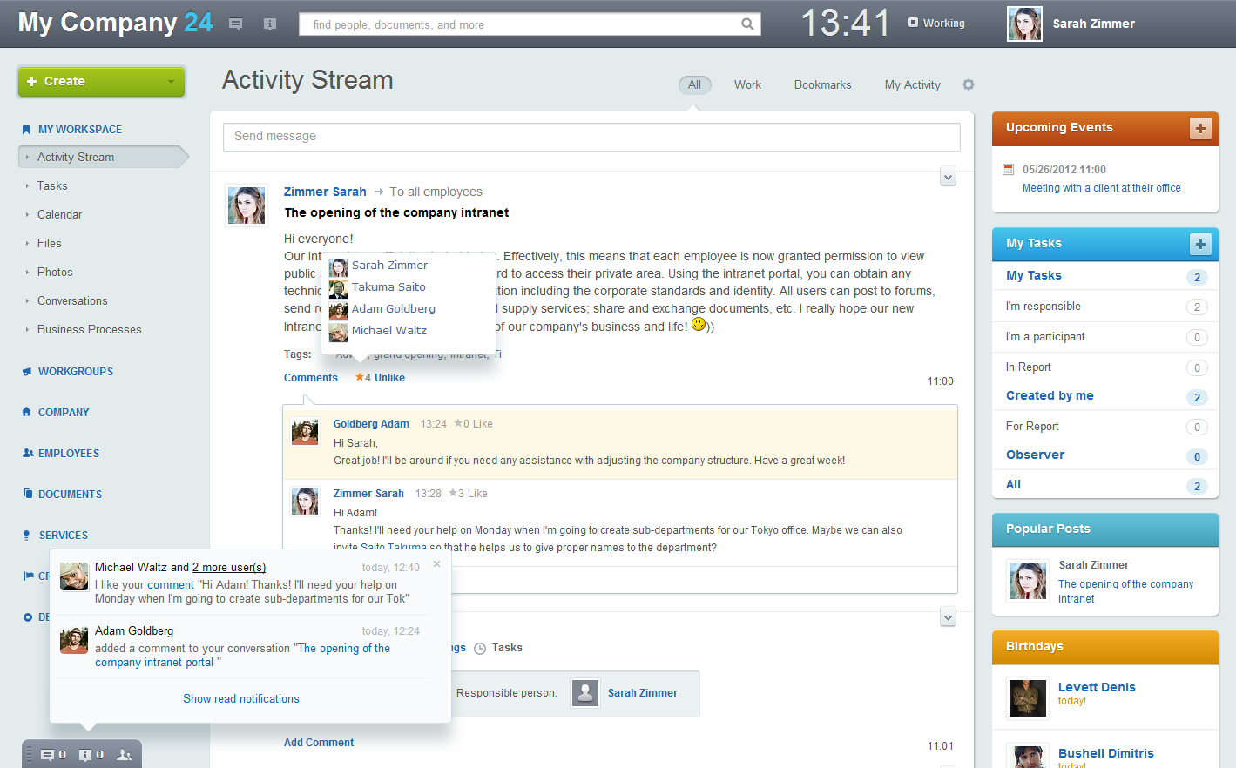
Classic Intranet and Social Intranet
Bitrix Intranet 11.5 provides two product templates to choose from, depending on the desired user experience: a Classic Intranet template, and a new Social Intranet template that gives prominence to social interaction.

Slide 4
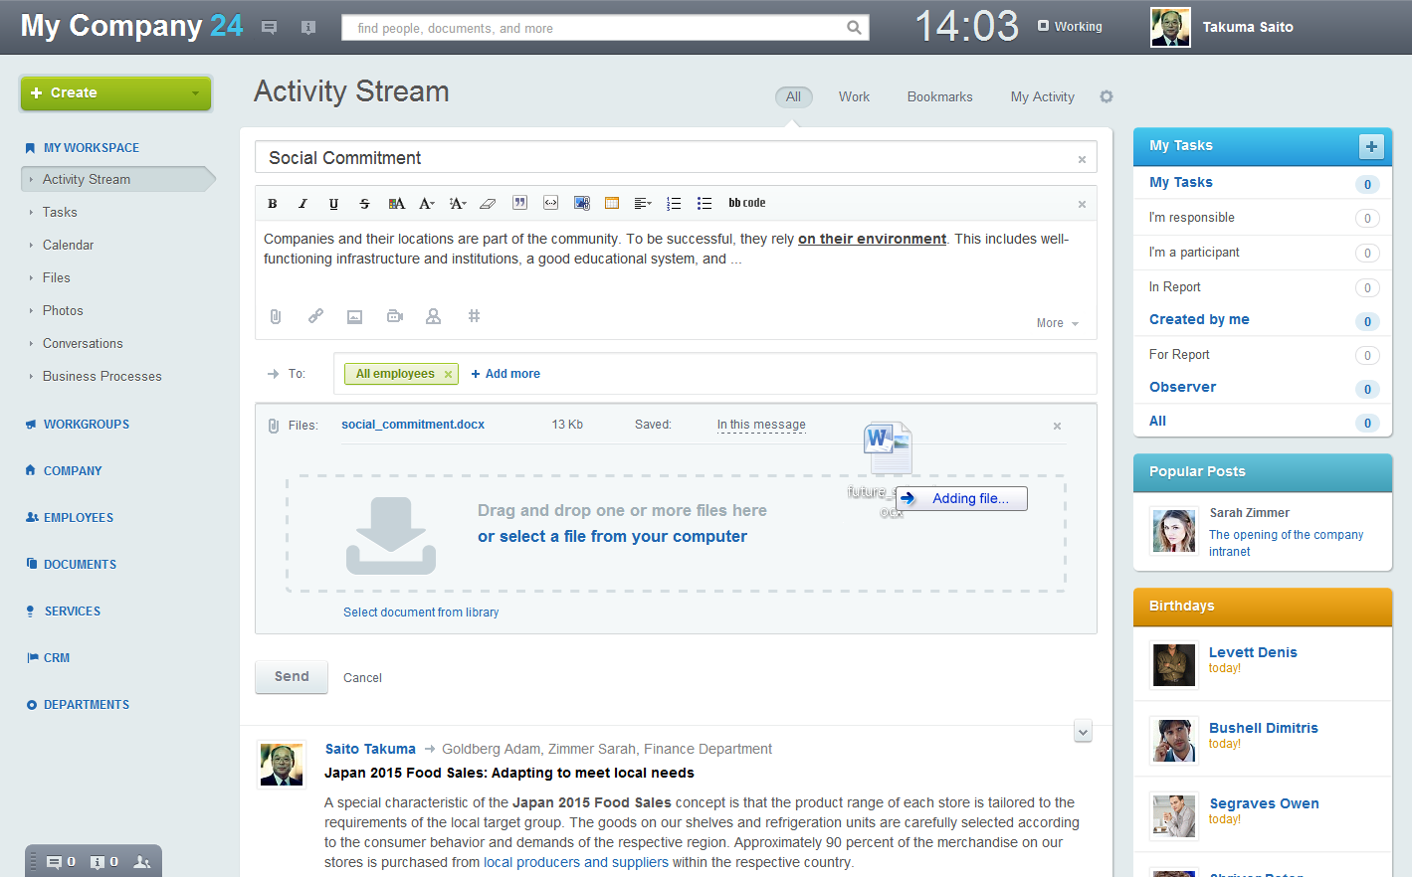
Social Intranet template
The new template greatly simplifies navigation and reduces the time needed for new employees to get completely comfortable in the environment. All tools, buttons, menus, etc. are intuitive and always at hand.

Slide 5
Activity Stream
The Activity Stream is a single-point for employees to get updates on projects and workgroups, carry on discussions with colleagues, view comments, receive documents and files, and manage or create new tasks, etc.

Slide 6
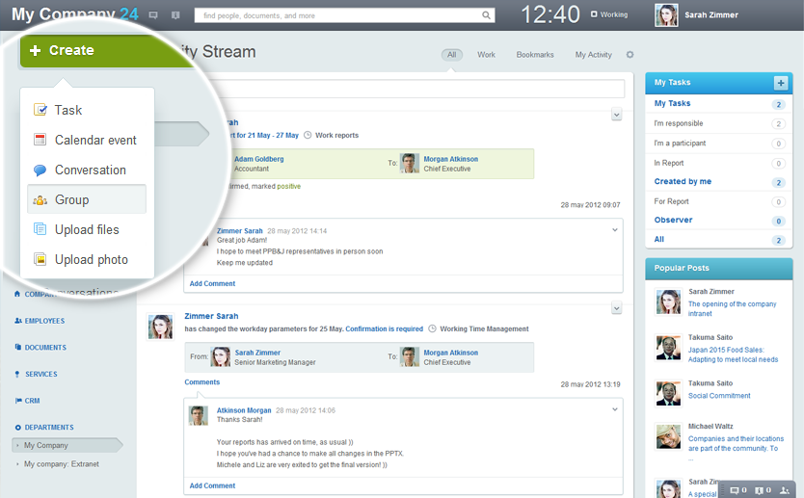
Create Button
The Create Button (only in Social Intranet template) reduces excess navigation inside the Intranet allowing intranet users to initiate tasks, send messages, schedule calendar events, upload files and even create new workgroups.

Slide 7
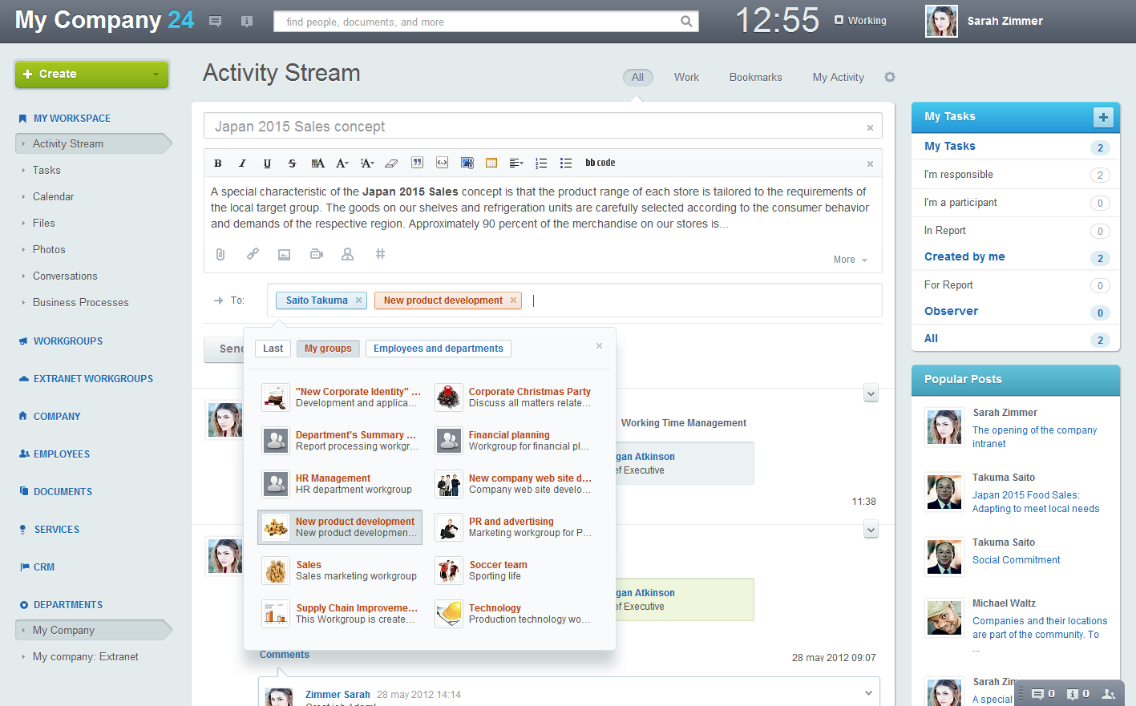
Conversations and Discussions
Messages or Conversations that show up in the Activity Stream are received by individuals or workgroup users. Each conversation can be continued with comments or attached files, photos, and videos.

Slide 8
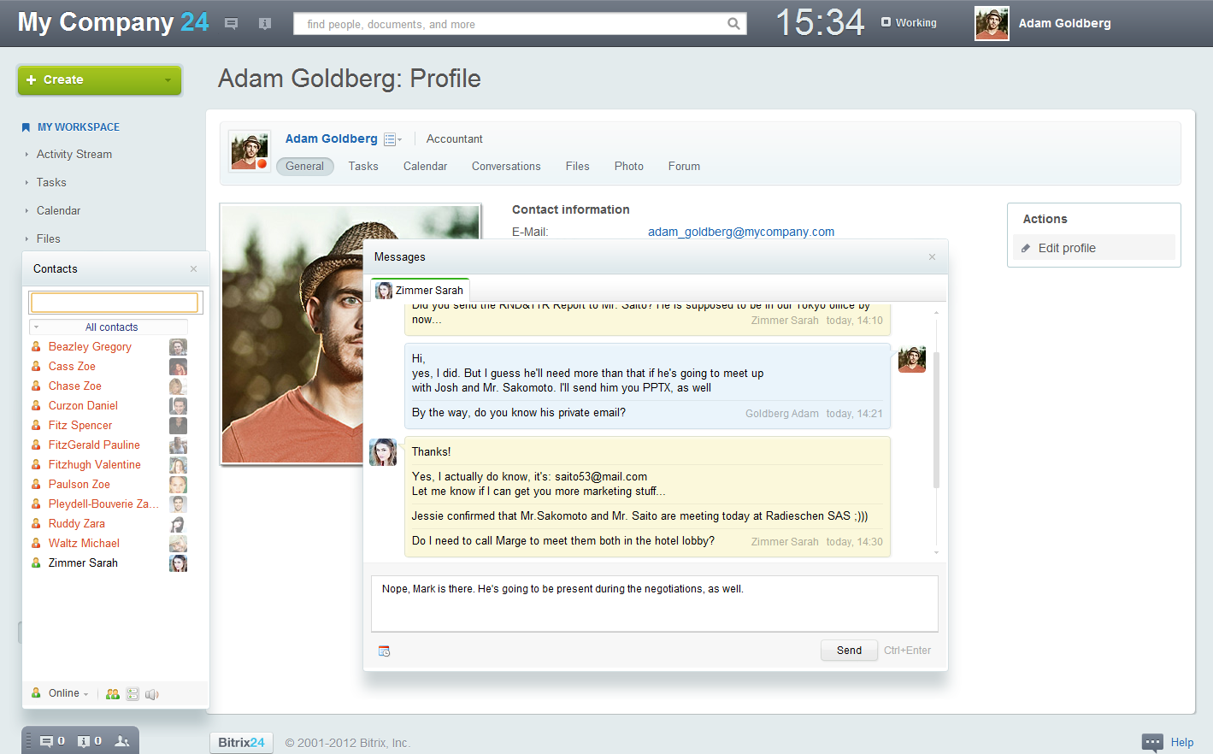
Instant Messenger & Notifications
The built-in Instant Messenger is a perfect way to communicate quickly without interrupting work and get updates (notifications) on task and document changes. IM has a full, searchable archive of messages, as well.

Slide 9
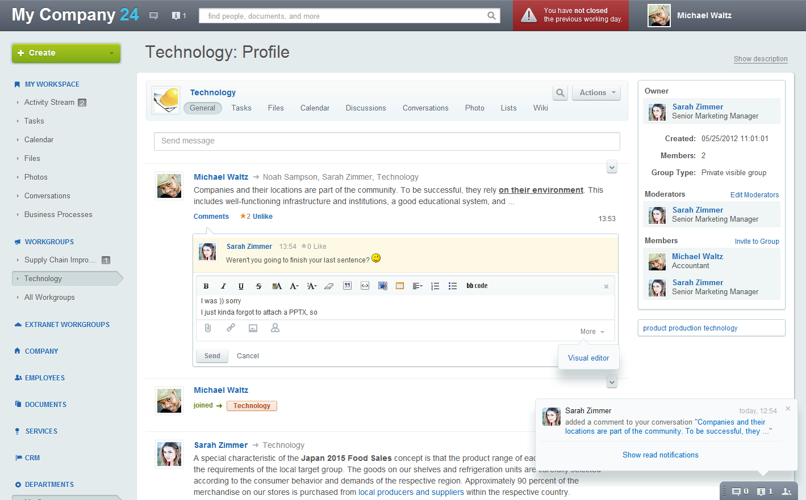
Navigation in Workgroups
The design and navigation within Workgroups are significantly rearranged, with more reliance on the Activity Stream. Tasks, photos, liking, and comments can all be viewed and worked on from the Activity Stream.

Slide 10
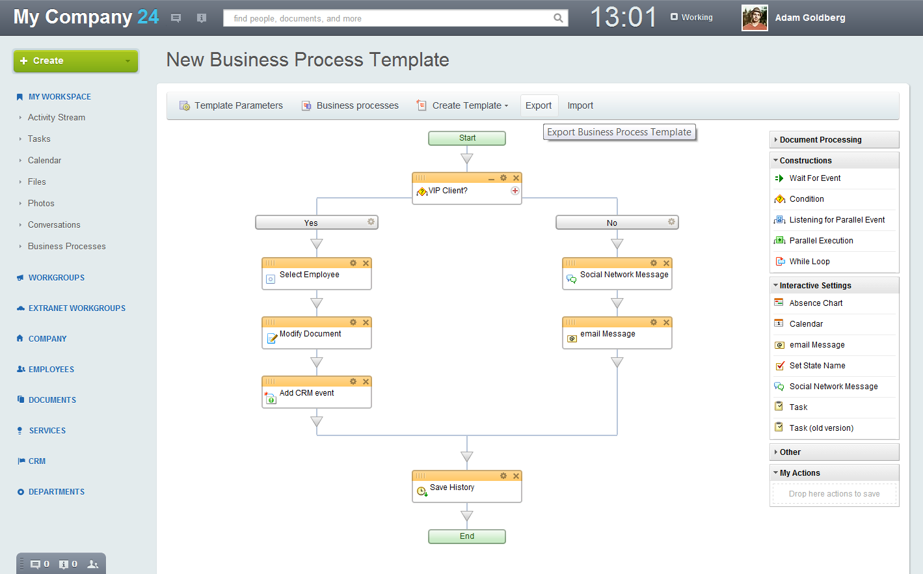
CRM & Tasks in Business Processes
In version 11.5, the Business Processes module integrates with Tasks and the CRM. This integration allows for creating new tasks, processing leads and even generating automatic reports at any stage of a Business Process.

Slide 11
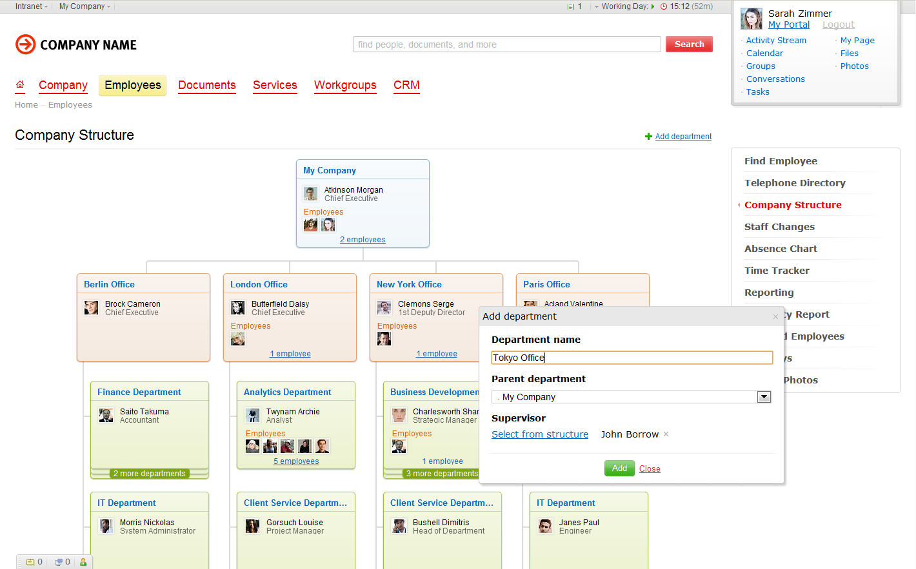
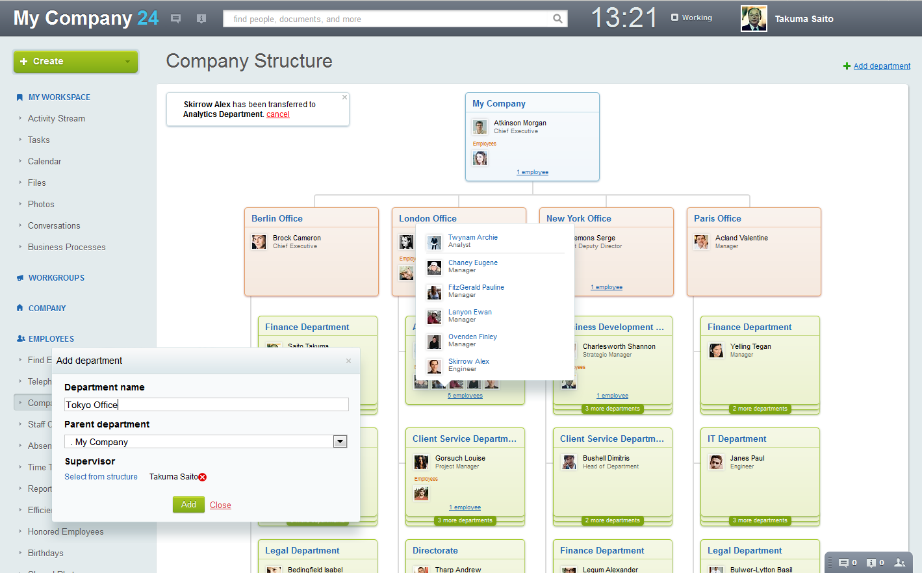
Enhanced visual Company Structure
The new Company Structure employs drag-and-drop technology for moving employees, creating departments, and specifying department heads. These changes will also influence reporting and tasks fulfillment scenarios.

Slide 12
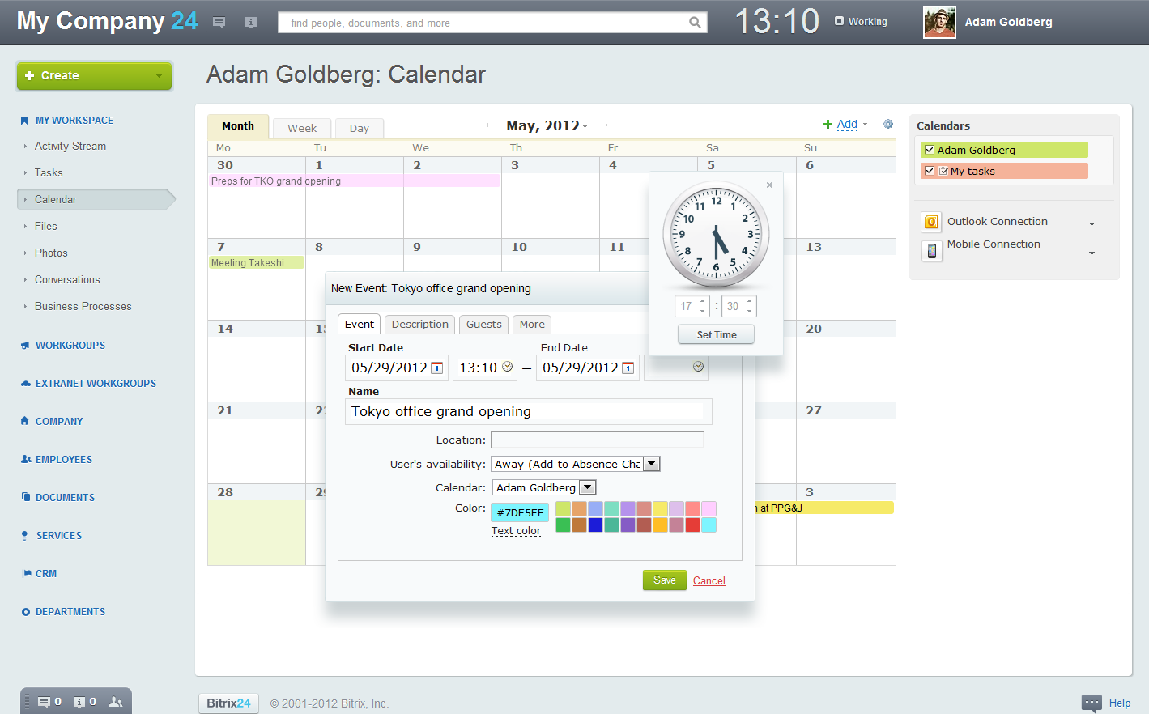
Enhanced Calendar grids
Calendars have a new user-friendly interface and enhanced functionality for adding and editing events. The Calendar grids can display tasks and events bound to CRM objects. The Calendar parameters can be adjusted individually.

Slide 13
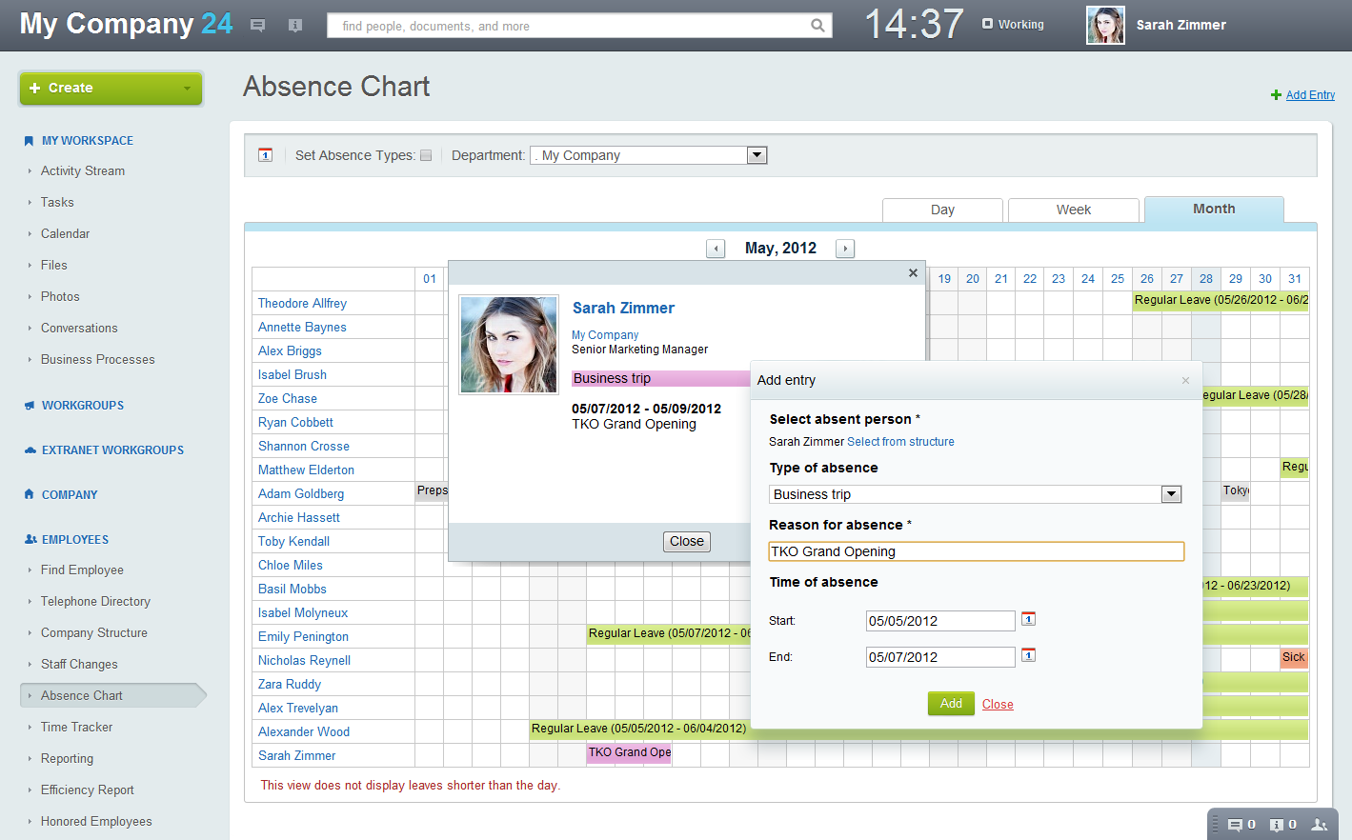
Absence Chart improvements
After creating a new entry, it is immediately visible on the Calendar grid. This new dialog will be very useful for the HR department staff when entering various types of leaves for employees.

Slide 14
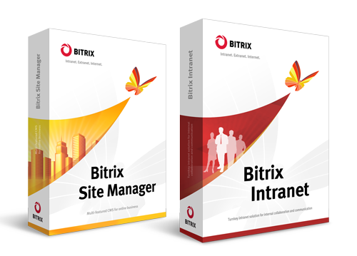
Fresh Look & Price Changes
Bitrix Intranet Editions & Prices:
InfoPace Edition: $1,299
TeamPace Edition: $2,299
BizPace Edition: $3,299
BizPace Enterprise: $9,990
Download Marketing Kit
Compare editions online
Bitrix products have changed their appearance. Although the product is supplied electronically, visual representation plays a crucial role in marketing campaigns - both online and offline. Check out the new pricing, too!

Slide 15
Thank you!
Free demo: www.bitrixsoft.com/intranet

